Slide 1
A Comparative Study of Programming Languages in Rosetta Code
Nanz, Sebastian and Carlo A. Furia.
Presentation: Nir Attar

Slide 2
Time allocation – hidden
Overview 5
Programming paradigms overview 20
Research Setup 5
Results:
RQ1 – Conciseness 5
RQ2 – Executable Size 5
RQ3 – Running time 5
RQ4 – Memory usage 5
RQ5 – Error proneness 5
Conclusion 5
Haskell 10
Go 5 ……………… TOTAL: 80

Slide 3
Overview

Slide 4
Research Questions

Slide 5
Results

Slide 6
Conciseness
RQ1 : Which programming language make for more concise code ?

Slide 7

Results format
Gambling:
Which paradigms are better/worse?
Big Winner? (specific language)
Big Loser?
Ratio

Slide 8
Conciseness
RQ1 : Which programming language make for more concise code ?
Non-comment, non-blank lines of code
Not required to run correctly, or even compile
Shortest solution for each task in a language

Slide 9
Why it is important?
Bug density is constant across programming languages.
(Meaning – shorter means less bugs.)¹
Readability

Slide 10
Example – File I/O
Read file into buffer (in chunks), output to another file.

Slide 11
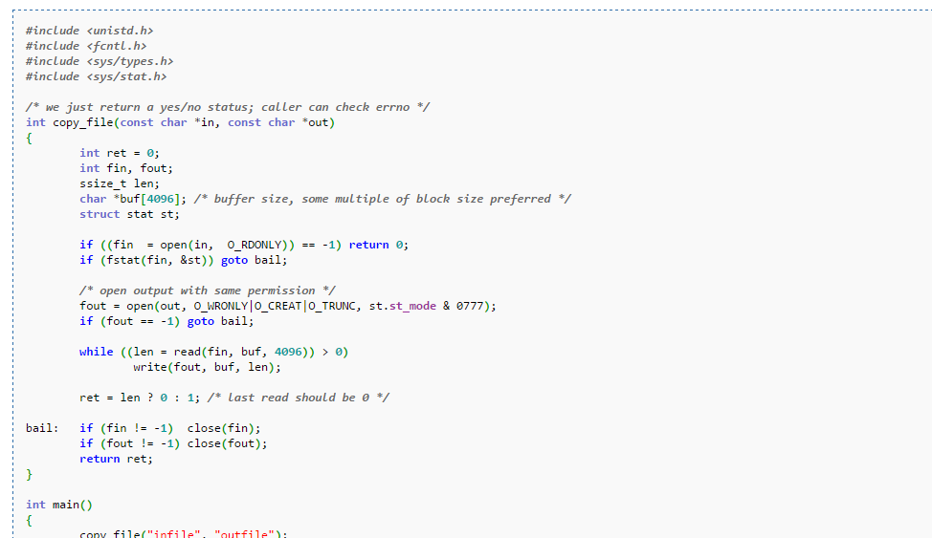
C

Slide 12
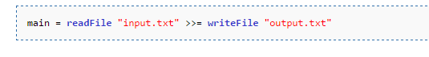
Haskell

Slide 13
What might improve conciseness?
Simplified, expressive syntax
Objects, abstractions
Less checks on variable’s state
Use of external libraries
String interfaces
Collection interfaces

Slide 14
Any guess ?
Gambling:
Which paradigms are better/worse?
Big Winner? (specific language)
Big Loser?
Ratio

Slide 15
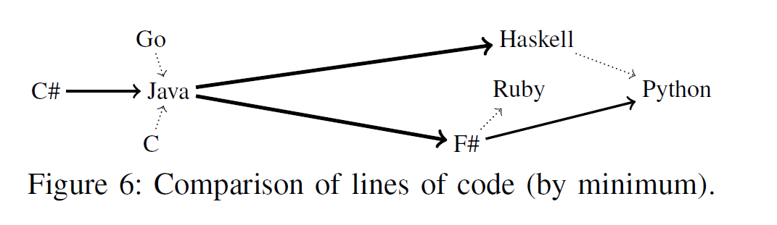
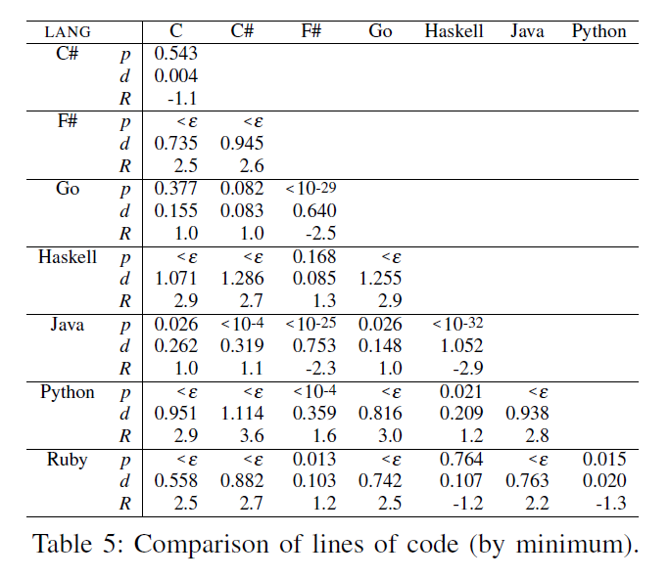
Results – RQ1 (Conciseness / Lines of code)

Slide 16
Conciseness (Lines of code)
Languages divided into two groups:
Group 1: functional and scripting – more concise
Group 2: OO and procedural – longer code
Major differences. i.e. Java 2.2-2.9 longer than Group 1.
Within the groups – no major difference.
Winner (by small amount): Python

Slide 17
Results – RQ1 (Conciseness / Lines of code)

Slide 18
Size Of Executable
RQ2 : Which programming language compile into smaller executables ?
Only those compiled successfully.
Languages are divided by whether they:
Compile into byte-code
Compile into native code
Ruby language – excluded, has no executable (interpreted).

Slide 19
Why is it important?
Executable is saved on HD, transported on network.
Executable (at least parts of it) is loaded into memory. (more at RQ4)
May turn irrelevant as years go by: HD sizes and speed increase (SSD).
Embedded systems.

Slide 20
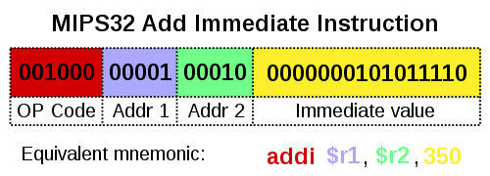
Native code
Code that is compiled to run with a particular processor (such as an Intel x86-class processor) and its set of instructions.
Programs compiled into native code:
C, C++, Go, Haskell

Slide 21
Byte-code
An intermediate instruction set, to which source code is compiled.
Then, Byte code can be either :
Interpreted by interpreter/Virtual machine.
Compiled to native code on demand (JIT compilation).
Highly portable.
Programs compiled into byte code:
Java, Python, C#, F#

Slide 22
Size Of Executable
RQ2 : Which programming language compile into smaller executables ?
Byte-code ? (Java, Python, C#, F#)
Native code ? (C, Go, Haskell)

Slide 23
Static vs. Dynamic linkage
If static libraries are called, the linker will copy all the modules referenced by the program directly into the executable.
Dynamic Linking Allows a process to add, remove, replace or relocate object modules during its execution.

Slide 24
Static vs. Dynamic linkage
…

Slide 25

Any guess ?
Gambling:
Which paradigms are better/worse?
Big Winner? (specific language)
Big Loser?
Ratio

Slide 26
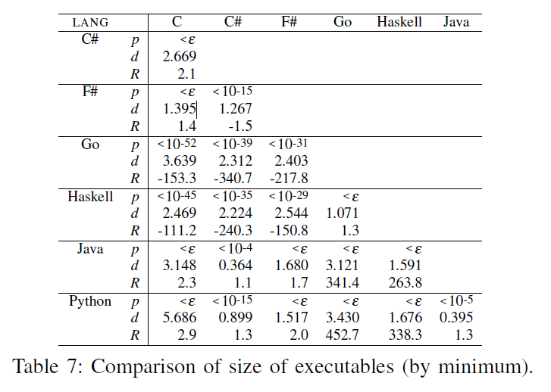
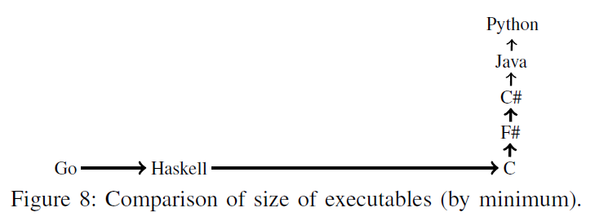
Results – RQ2 (Size of executable)

Slide 27
Size of Executable
Three consecutive groups:
Group 1: Native, Large executables (Go, Haskell)
Group 2: Native, Small executable (C)
Group 3: Bytecode, Small executable (F#, C#, Java, Python)
Winner (by small amount): Python
Losers: Go, Haskell
Ratio: Big, i.e. Java program 263 times smaller than Haskell !

Slide 28
Size of Executable
Languages that compile to byte code – are significantly smaller.
Languages that prefer Static linking produce much larger executables.

Slide 29
Running Time
RQ3 : Which programming languages have better running-time performance ?
Measure running time.
Small set of “Scalability tasks” – tasks that their input can be scaled up to create computing-intensive workload.
Exclude programs with errors and timeouts (over 3 mins.)

Slide 30
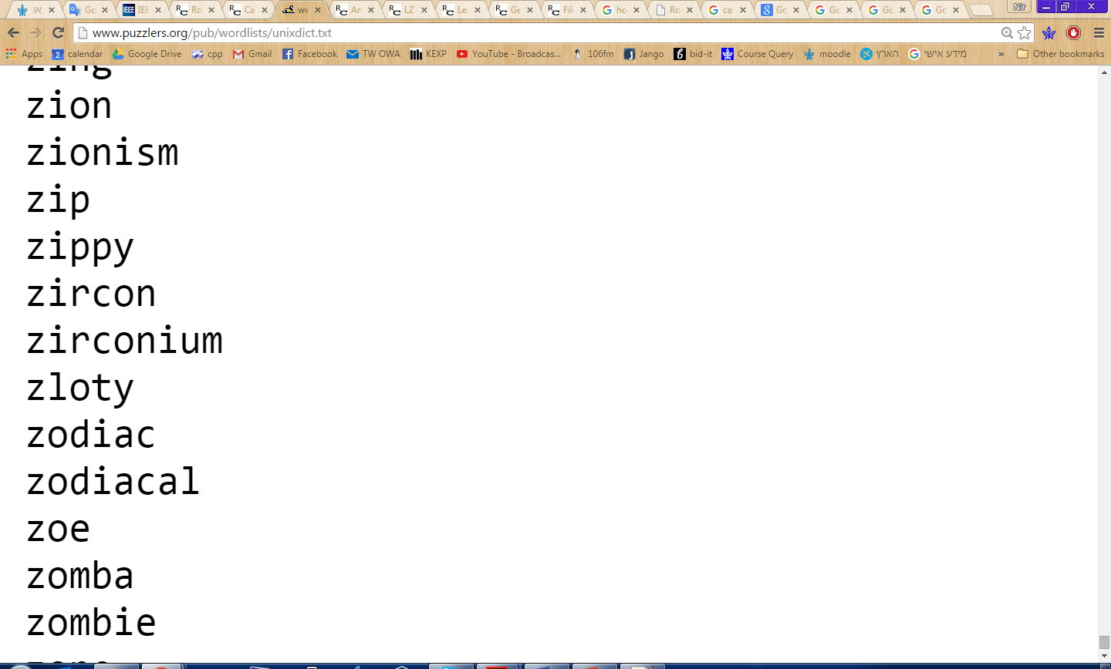
Running Time
Example: Anagrams
Anagram = two words that have the same letters in different order. i.e. veil, levi
Task: on the dictionary in unixdict.txt, find the longest sets of anagrams (sets that contain the most words).

Slide 31
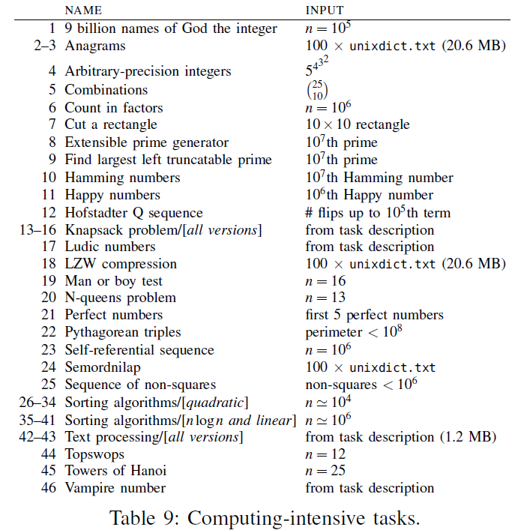
“Scalability tasks”

Slide 32
Running Time
“Scalability tasks” – all programs ran on very same inputs.
Text-processing tasks (Anagrams, Semordnilap).
Combinatorial puzzles (N-Queens problem, Towers of Hanoi).
NP-Complete problems (Knapsack).

Slide 33
Running Time - Why it is important?
Well, duh…
However:
In real-time systems it is critical.
Systems with performance needs – large inputs (i.e. web traffic).
On “information”/”everyday“ type applications – maybe less important?
“Most applications do not actually need better performance than Python offers”¹

Slide 34
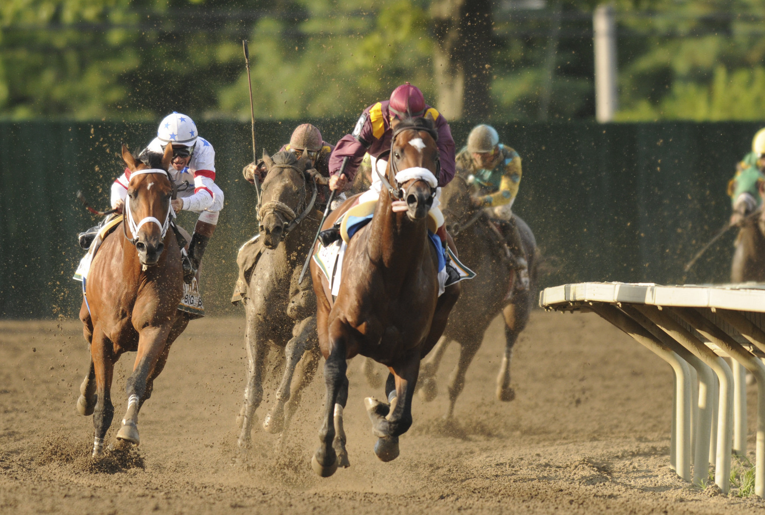

Slide 35


Slide 36


